Slide 1
Topic 1: The Linux Community and a Career in Open Source
How to Prepare for the LPI Linux Essentials Certification Exam
C851 Cohort Session for Sunday, August 15, 2021
Dr. John S. Galliano | C851 Linux Foundations Instructor

Slide 2
Agenda
Welcome
About the Exam
The 5 Exam Domains
Topics/Weightings
LPI Retake Policy
Demos/Hands-on
Sample Exam Questions
Wrap-Up

Slide 3

About the Linux Essentials v1.6 [1]
No prerequisites
Closed book, up to 60 minutes
40 multiple-choice (with some multi-select and fill-in-the-blank items) questions
Minimum pass score 500 points (200-800 scale)
Partially correct responses not accepted (for F-I-T-B questions LPI may accept multiple correct versions of an answer [2]
Total exam weight count is 40, thus 40 questions
Ex: If an objective has a weight of 4, there will be [2] questions on the exam related to that objective
[1] Linux Professional Institute, “Linux Professional Institute Linux Essentials,” Linux Professional Institute, 21-Oct-2018. [Online]. Available: https://www.lpi.org/our-certifications/linux-essentials-overview. [Accessed: 14-Aug-2021]
[2] Dr. Galliano’s correspondence with LPI, dated August 2021: Example: with/without leading path in a case where the answer is a command

Slide 4

5 Exam Domains [3]
The Linux Community and a Career in Open Source
Finding Your Way on a Linux System
The Power of the Command Line
The Linux Operating System
Security and File Permissions
[3] Linux Professional Institute, “Linux Essentials Objectives V1.6 - LPI Wiki,” Linux Professional Institute, 25-Jan-2020. [Online]. Available: https://wiki.lpi.org/wiki/Linux_Essentials_Objectives_V1.6. [Accessed: 14-Aug-2021].
Notes:
• Understanding the Linux industry and the open source movements
• Understanding the major components of a Linux distribution
• Gaining the technical proficiency to work on the Linux command line
• Gaining a basic understanding of security and administration in Linux
• Gaining a basic understanding of how to work with users, groups, and permissions

Slide 5

Exam Topics/Weightings
Linux Essentials v1.6 Exam Topics [4] | 1.1 | 2
 | 1.2 | 2
 | 1.3 | 1
 | 1.4 | 2
 | 2.1 | 3
 | 2.2 | 2
 | 2.3 | 2
 | 2.4 | 2
 | 3.1 | 2
 | 3.2 | 3
 | 3.3 | 4
 | 4.1 | 1
 | 4.2 | 2
 | 4.3 | 3
 | 4.4 | 2
 | 5.1 | 2
 | 5.2 | 2
 | 5.3 | 2
 | 5.4 | 1
 |  | 40
A weight of “1” equates to 1 exam question
[4] Linux Professional Institute, “Linux Essentials Objectives V1.6 - LPI Wiki,” Linux Professional Institute, 25-Jan-2020. [Online]. Available: https://wiki.lpi.org/wiki/Linux_Essentials_Objectives_V1.6. [Accessed: 14-Aug-2021].

Slide 6

LPI Exam Re-Take Policy [5]
Anyone who takes an LPI exam once must wait one week before re-taking
Anyone who takes an LPI exam a second (and subsequent) time must wait 30 days before re-taking
Anyone who passes an LPI exam may not retake that exam for two years
[5] Linux Professional Institute, “Privacy Statement and Policies,” Linux Professional Institute, 18-May-2018. [Online]. Available: https://www.lpi.org/policies. [Accessed: 14-Aug-2021].

Slide 7

1.1 Linux Evolution and Popular Operating Systems 1.2 Major Open-Source Applications 1.3 Open-Source Software and Licensing 1.4 ICT Skills and Working in Linux [6]
Weight: 2, 2, 1, 2 (7 questions)
Key Knowledge Areas:
Distros, Embedded Systems, Linux in the Cloud
Desktop/Server applications, Development languages, Package management tools and repos
Open-source philosophy, licensing, Free Software Foundation (FSF), Open-Source Initiative (OSI)
Desktop skills, Getting to the command line, Industry uses of Linux, cloud computing and virtualization
[6] Linux Professional Institute (LPI), “Exam 010 Objectives,” Linux Professional Institute, 21-Oct-2018. [Online]. Available: https://www.lpi.org/our-certifications/exam-010-objectives. [Accessed: 10-Jul-2021].

Slide 8
1.1 Linux Evolution and Popular Operating Systems 1.2 Major Open-Source Applications 1.3 Open-Source Software and Licensing 1.4 ICT Skills and Working in Linux [7]
Weight: 2, 2, 1, 2 (7)
Files used, terms, and utilities:
Debian, Ubuntu (LTS), CentOS, openSUSE, Red Hat, SUSE, Linux Mint, Scientific Linux, Raspberry Pi, Raspbian, Android
OpenOffice.org, LibreOffice, Thunderbird, Firefox, GIMP, Next/ownCloud
Apache, NGINX, MariaDB, MySQL, NFS, Samba
C, Java, JavaScript, Perl, shell, Python, PHP
dpkg, apt-get, rpm, yum
Copyleft, Permissive, GPL, BSD, Creative Commons
Free Software, FOSS, FLOSS
Using a browser, configuration options, searching the web, saving content
Terminal and console
Passwords, Privacy issues
Open-source apps in presentations and projects
[7] Linux Professional Institute (LPI), “Exam 010 Objectives,” Linux Professional Institute, 21-Oct-2018. [Online]. Available: https://www.lpi.org/our-certifications/exam-010-objectives. [Accessed: 10-Jul-2021].

Slide 9
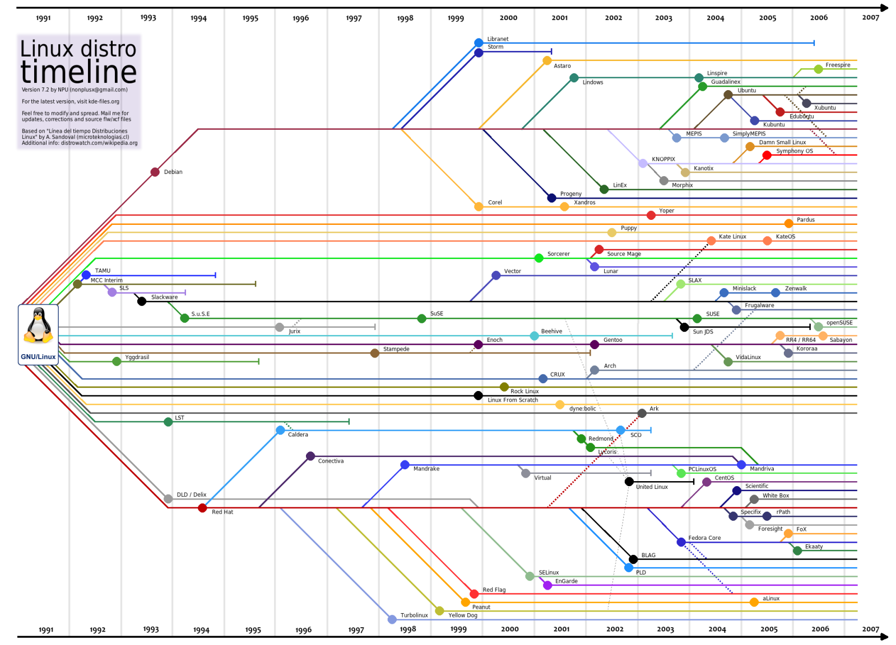
1.1 Linux Evolution and Popular Operating Systems
DEBIAN
SLACKWARE
ARCH
RED HAT
[8] A. Lundqvist, D. Rodic, M. Mustafa, M. Herdiansyah, and F. Loli, “GNU/Linux Distributions Timeline v20.10,” Wikipedia, 25-Oct-2020. [Online]. Available: https://upload.wikimedia.org/wikipedia/commons/1/1b/Linux_Distribution_Timeline.svg. [Accessed: 14-Aug-2021].

Slide 10

1.1 Linux Evolution and Popular Operating Systems
Embedded Systems
Systems enclosed in products, of special purpose, and stored on a chip
Cloud
Compute workload running
Clouds are where applications run
Software/hardware used to build cloud resources
Leverages virtualization/containerization
Very flexible in meeting demand
Pay as you go (typically)
Demos
https://www.distrowatch.com
https://distrotest.net/
https://jslinux.org/
https://aws.amazon.com

Slide 11

1.2 Major Open-Source Applications
Open vs. Closed [9]
Open-Source Software: source code made freely available and may be freely redistributed and modified
Closed-Source Software: source code is NOT shared nor is redistributable; a.k.a., proprietary software
Android vs. iOS
Development Languages
C, Python, Java, Rust, Go
Package Management/Repos
Red Hat: rpm + yum, dnf
Debian: dpkg + apt
Slackware: aur, pacman, zypper
[9] eThink, “Open-Source LMS Vs. Closed-Source: What’s The Difference?,” EThink | Hosted MoodleTM & Totara LMS, 18-Sep-2017. [Online]. Available: https://ethinkeducation.com/blog/open-source-vs-closed-source-technology-lms/. [Accessed: 14-Aug-2021].

Slide 12
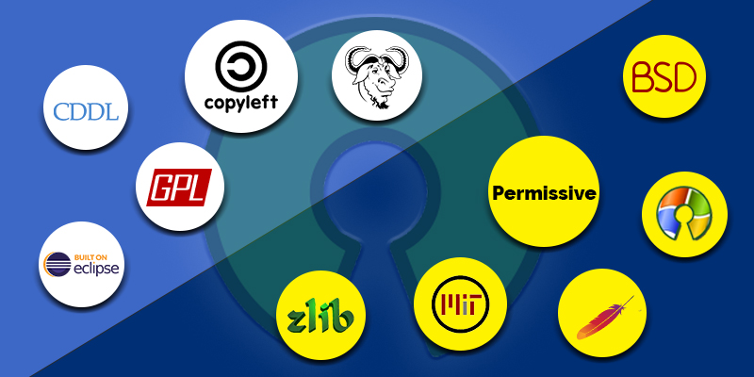
1.3 Open-Source Software and Licensing
GNU General Public License (GPL)
GNU/Richard Stallman
Copyleft [10] (basically all rights remain intact)
full source code and all rights to modify and distribute the entire code
Apache License (ASF)
allows you to freely use, modify, and distribute any Apache licensed product
grants patents rights
Berkeley Software Distribution (BSD) License
you may freely modify/distribute source code but must retain a copy of the copyright notice, list of conditions, and a disclaimer
contains an advertising clause and a non-endorsement clause
Massachusetts Institute of Tech (MIT) License
Very permissive free software licenses
Do whatever you want with source code IF you add a copy of the original MIT license and copyright notice
[10] The GNU Project, “What Is Copyleft?,” Free Software Foundation, 15-Dec-2018. [Online]. Available: https://www.gnu.org/licenses/copyleft.en.html. [Accessed: 14-Aug-2021].

Slide 13
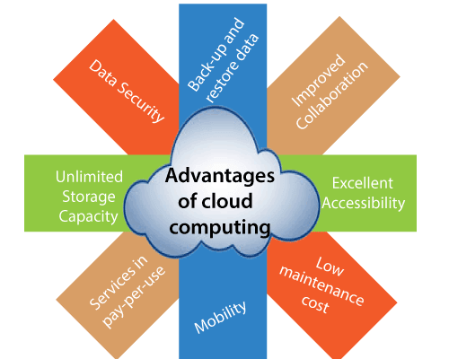
1.4 ICT [11] Skills and Working in Linux
Desktop skills
technology in everyday tasks: sending an email, attending a video conference, searching the Internet, etc.
user-facing security/privacy issues
Getting to the command line
the terminal, what else?
your shell, your history, your path, your data
Industry uses of Linux, cloud computing, and virtualization
Infrastructure as a Service (IaaS) offerings
“ready to run” popular Linux distros
customized versions of Linux
[11] M. R. Gillings, M. Hilbert, and D. J. Kemp, “Information in the Biosphere: Biological and Digital Worlds,” Trends in Ecology & Evolution, vol. 31, no. 3, pp. 180–189, 2016, doi: 10.1016/j.tree.2015.12.013.

Slide 14

Let’s Do Some Demos!
If you want to follow along, fire up your VM
Notes:
• Understanding the Linux industry and the open source movements
• Understanding the major components of a Linux distribution
• Gaining the technical proficiency to work on the Linux command line
• Gaining a basic understanding of security and administration in Linux
• Gaining a basic understanding of how to work with users, groups, and permissions

Slide 15
What Questions Do you Have for Me?

Slide 16
Backup
Linux has 3 basic file types:
Ordinary/regular files
Directories
Special files
Directories store:
store ordinary and other special files
organized in a hierarchy starting from the root (/) directory
Special files communicate or point:
block files with device drivers
character files via unbuffered serial access with system hardware (1 character at a time)
pipes/named pipes for inter-process comms, connecting the output of one process to the input of another process
socket files to transfer data and information between processes running in different environments
symbolic links reference another file (think of these links as “pointing” to other files like directories or regular files)

Slide 17
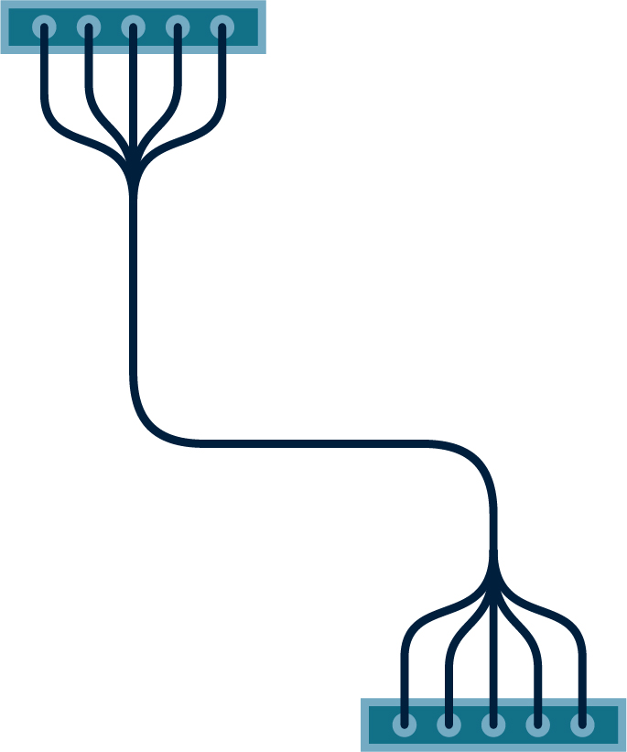






























Icon Library - Page 1

Slide 18



























































Icon Library - Page 2

